Slide 1

Lecture 4
TensorFlow

Slide 2

A G E N D A
Overview of tensorflow
Building a deep network with tensorflow
Advantages & disadvantages of tensorflow

Slide 3
Overview of Tensorflow
Notes:
Without further adieu, Let’s look at the course introduction so that you will know what you are going to learn.

Slide 4
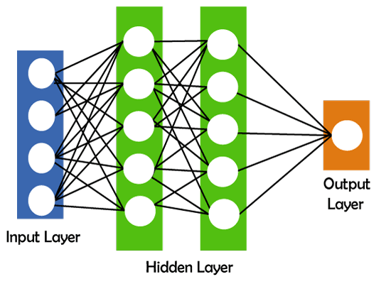
Recap of Deep Learning
What is Deep Learning?
"Deep learning is defined as the subset of machine learning and artificial intelligence that is based on artificial neural networks". In deep learning, the deep word refers to the number of layers in a neural network.
Deep learning can be useful to solve many complex problems with more accurate predictions such as image recognition, voice recognition, product recommendations systems, natural language processing (NLP), etc.

Slide 5
Why do you need a deep learning framework?
Speed:
Fast implementations of matrix multiply, convolutions and backpropagation such complicated computation
Cuda implementations that are simple to use
Automatic differentiations
Finished implementations of the most common gradients
Reuse:
Reuse other people's models
Evaluate other models correctly
Updates your implementation to new hardware
The more code you write yourself, the more errors
Updates:

Slide 6

What is Tensorflow?
TensorFlow is an open-source machine learning library developed by Google that simplifies the process of building, training, and deploying machine learning models or deep neural network models. It is widely used in various fields such as image recognition, natural language processing and reinforcement learning. Tensorflow is powerful library on deep learning. We are going to learn the basic of tensorflow in this lecture.

Slide 7
How Tensorflow work?
TensorFlow uses a data flow graph model where nodes represent mathematical operations, and edges represent the flow of data (tensors) between them.
This graph-based approach enables efficient computation on CPUs, GPUs, or even specialized hardware like TPUs (Tensor Processing Units).
We will not cover the low-level technical concept of how actually tensorflow work in this lecture. In order to understand it, you will need advanced knowledge on Maths, Statistics and Computer Science.

Slide 8
Building a model in Tensorflow
Notes:
Without further adieu, Let’s look at the course introduction so that you will know what you are going to learn.

Slide 9
Overview
We are going to work out an example with Tensorflow. Let’s try out the example from tensorflow tutorial on the MNIST dataset. We are going to implement a handwritten digit recognition model based on the MNIST dataset using TensorFlow. By building and training a Convolutional Neural Network (CNN), we will learn how to extract features from raw image data and use those features for classification. We will go through the implementation step by step, so you will have a clear understanding on what is the example doing. Let’s start.
But first of all, what is MNIST and CNN?

Slide 10
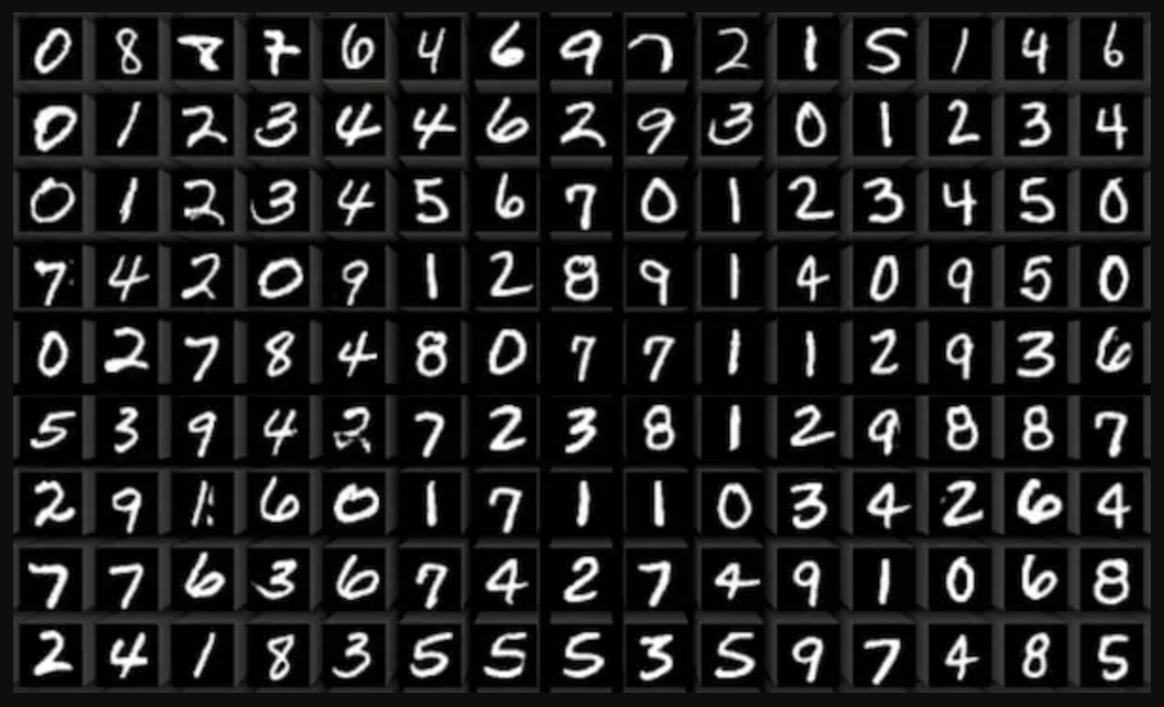
What is MNIST?
The MNIST dataset is a collection of handwritten digits (0-9) that is commonly used for training and testing machine learning models, particularly for image classification tasks.
It consists of 60,000 training images and 10,000 test images, each of which is a grayscale image of size 28x28 pixels.
Each image is labeled with the corresponding digit it represents, making it a labeled dataset suitable for supervised learning tasks.

Slide 11
Why is MNIST important for new learner of deep learning?
MNIST is often considered the "Hello World" of deep learning because it serves as a simple yet effective starting point for understanding how neural networks can be trained to recognize patterns in data.
Working with the MNIST dataset helps beginners grasp fundamental concepts such as data preprocessing, model building, training, and evaluation in a straightforward manner.
Many tutorials, courses, and research papers use the MNIST dataset as a benchmark to showcase the effectiveness of different deep learning architectures and techniques.

Slide 12
What is the application of MNIST?
The MNIST dataset is commonly used to develop and evaluate handwritten digit recognition models, where the goal is to correctly classify each image into the corresponding digit class.
It serves as a foundational dataset for exploring various neural network architectures, such as convolutional neural networks (CNNs), which are particularly well-suited for image recognition tasks.
Beyond digit recognition, the principles learned from working with the MNIST dataset can be extended to more complex image datasets and real-world applications of deep learning.

Slide 13
What is Convolutional networks (CNN)?
Imagine you have a model that can recognize different shapes and patterns in what you see. These model help you identify whether you are looking at a cat, a dog, or a car. A Convolutional Neural Network (CNN) is type of this kind of neural network model. It's a type of artificial intelligence that is designed to recognize and understand visual patterns, just like how your brain does when you see things.
A CNN breaks down images into smaller parts and looks for specific patterns, like edges, textures, or colors. Then it will learn those patterns and able to identify different classes base on the patterns they learn. For example, let use back the MNIST as example, if you give a digital image with the number “4” and asking what is the number, it will recognize it and output “4” for you.
The CNN usually consists of 3 fundamental part, the Convolution layers, Pooling layers and the Fully connected layers.

Slide 14
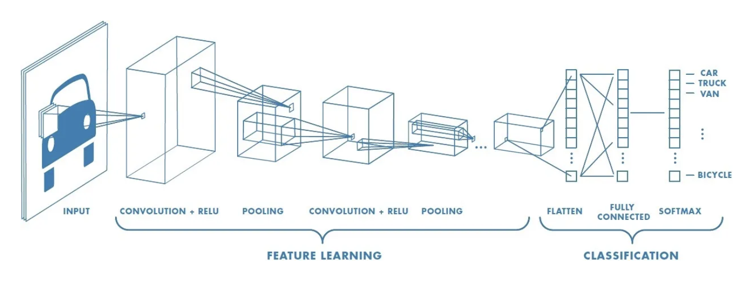
Convolution Layers
These are the layers in the network where the actual "magic" happens. The CNN scans the image with small filters (aka. kernel) to detect these patterns. Each filter focuses on a different aspect of the image.
You don’t need to know the mechanism on how it work, you will need advanced knowledge on maths, statistic and computer graphics to understand everything here which we will not cover in this lecture.

Slide 15
Pooling Layers
After detecting features, the network reduces the information by downsampling it. It basically try to reduce the sample size to make it easier for training because it helps keeping the important information while making the training processing faster with least computation.

Slide 16
Why many convolution and pooling?
You see usually we will have many convolution layers and pooling layers, this allow us filtering out the most important information from the data while downsizing the sample size. This will make training process more efficient and effective with less computation afterwards.

Slide 17
What is RELU?
You maybe be curious on the term RELU and wonder what is it. RELU is a type of activation function. Imagine you have a light switch in your room that can be either ON or OFF. In the world of neural networks, an activation function is like that switch. It decides whether a neuron in a neural network should be activated (fired) or not based on the input it receives.
Neural networks use activation functions to introduce non-linearities into the system. This non-linearity is crucial because it allows neural networks to learn complex patterns and relationships in data that linear functions cannot capture.
There are many type of activation function and RELU is one of the example. You don’t need to know how it actually work, just to remember it is very important here and we will use RELU to act as a switch to control what pattern or feature we want to extract from the image. If ON, then extract. If Off, then omit it.

Slide 18
Fully Connected layer
Once the network has identified all the important features, it puts them together to make a final decision. For example, if it sees pointy ears and whiskers, it might guess that it's a cat. This is what Fully connected layer done for this task. It basically is the “actual” part that look like a traditional “Neural Network” in a CNN.

Slide 19
What is Softmax?
Softmax is often used as activation function in the output layer for multi-class classification problems. It is an activation function that converts the final layer outputs into probabilities. For example, if the CNN sees pointy ears and whiskers, it might guess that it's a cat but firstly it need to turn its results into probability so it could tell you “how likely” it thinks the image is a cat image. Just to remember that we use Softmax in multi-class classification problem very often.

Slide 20
Overview
Now we know what is MNIST and CNN. Next step is to learn how to implement all these step with Tensorflow. We will create our own CNN model step by step with powerful Tensorflow pre-built models and functions.

Slide 21
Implement CNN with Tensorflow
1. Import necessary libraries and load the dataset
#Import necessary libraries
Import pandas as pd
import numpy as numpy
from tensorflow.keras.datasets import mnist
import matplotlib.pyplot as plt #Load MNIST Dataset
(x_train, y_train), (x_test, y_test) = minst.load_data()

Slide 22
Implement CNN with Tensorflow
2. Import the Tensorflow modules for building CNN model
#Import necessary libraries
from tensorflow.keras.models import Sequential
from tensorflow.keras.layers import Dense, Conv2D, MaxPool2D, Flatten

Slide 23
Implement CNN with Tensorflow
3. Define and build our CNN model, compile it
#Build your model, compile it and train it
model = Sequential()
model.add(Conv2D(filters=32, kernel_size=(4,4),input_shape=(28, 28, 1), activation='relu',)
model.add(MaxPool2D(pool_size=(2, 2)))
model.add(Flatten())
model.add(Dense(128, activation='relu'))
model.add(Dense(10, activation='softmax'))
model.compile(loss='categorical_crossentropy', optimizer='adam', metrics=['accuracy'])

Slide 24
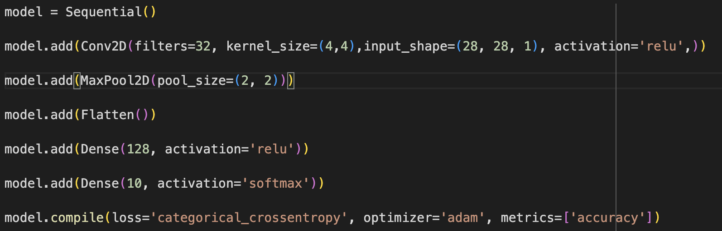
Implement CNN with Tensorflow
So we have build our CNN but what is going on here? What all this line of code doing?

Slide 25
Implement CNN with Tensorflow
We create a Sequential model here, it is like a builder of a Neural Network which we could define how is the neural network look by defining the architecture of it. We provide different building block to it and it will build the network for us in sequential order.
After we created the Sequential model, we want to add a convolution layer as the first layer of the model for feature/pattern extraction, this is what this line is doing.

Slide 26
Implement CNN with Tensorflow
Then we add a Max Pooling layer. Max Pooling is one type of pooling that we often used. There are other type of pooling.
Next, add a Flatten layer, this is required before we move on to the fully connected layer in next step after feature/pattern extraction and pooling. It is because we need to convert the multi-dimensional input into a format acceptable by fully connected layer.
We add 1 dense layer (fully connected layer) after the flatten layer, using relu as the activation function.

Slide 27
Implement CNN with Tensorflow
We add an output layer with a softmax function as the activation function for multiclass classification.
The last line is extremely important, we compile the Sequential model we just defined and setting the loss function, optimizer and performance evaluation metrics for the model. They are some crucial jargons in machine learning and deep learning. We will not cover these advanced concept and terms here so you don’t need to understand what they are and how they work. You only need to know that are essential on model training process.

Slide 28
Implement CNN with Tensorflow
4. Train the model
# Train the model & add early stop
from tensorflow.keras.callbacks import EarlyStopping
early_stop = EarlyStopping(monitor='val_loss',patience=2)
model.fit(x_train,y_cat_train,epochs=10,validation_data=(x_test,y_cat_test),callbacks=[early_stop])
We add a early stop callback here to stop the model training earlier if the model have low error. We train the model we compiled by calling model.fit() and pass in the training data. Set training epochs to 10 mean it use the whole training set data for training for at least 10 rounds. We also pass in the testing data for validation. After we execute the code, we wait patiently for the training to be done. Then, we have a trained CNN model. Now you know how to build a CNN model with Tensorflow!

Slide 29
Implement CNN with Tensorflow
5. Evaluate the model
# Evaluate the performance of the model
from sklearn.metrics import classification_report
print(model.metrics_names)
print(model.evaluate(x_test,y_cat_test,verbose=0))
predictions = model.predict_classes(x_test)
print(classification_report(y_test,predictions))
If the model has low loss and high accuracy, we said the model perform very well on predicting the number given from the MNIST dataset image.

Slide 30
Advantages & disadvantages of Tensorflow
Notes:
Without further adieu, Let’s look at the course introduction so that you will know what you are going to learn.

Slide 31
Advantages of Tensorflow
Good for research and production
Can run on different devices, desktop, laptop, mobile, cloud, etc.
A lot of functionality and available resources
Extensive documentation and tutorials for beginners to get started with, a lot of examples and demonstrations in the document
Many online courses and communities provide friendly support
Many Pretrained models
Tensorboard/visualization feature
Can be used with several languages

Slide 32
Disadvantages of Tensorflow
Steep learning curve, beginner find it difficult to learn
Not user friendly to new user without solid and strong maths or statistic background
A lot of functionalities, many functionalities will never need or being used
Different frameworks within tensorflow
Static graph building
Some implementations takes extra effort

